Slide 1
SEASONAL FLU VACCINE UPTAKE CLASSIFICATION PROJECT.
DR. JEREMY NGUGI

Slide 2
INTRODUCTION.
Influenza (flu) is a contagious respiratory illness caused by influenza viruses that infect the nose, throat, and lungs.
Last year, there were about 18000 deaths from seasonal flu in the US according to CDC.
Every person 6 months and above should be vaccinated every season(December to February)

Slide 3
INTRODUCTION
We want to understand the leading factors in determining whether people would take the seasonal flu vaccine.
We will then build a classifier to predict seasonal flu vaccination status using data they shared on their behaviors, opinions and demographic characteristics.

Slide 4
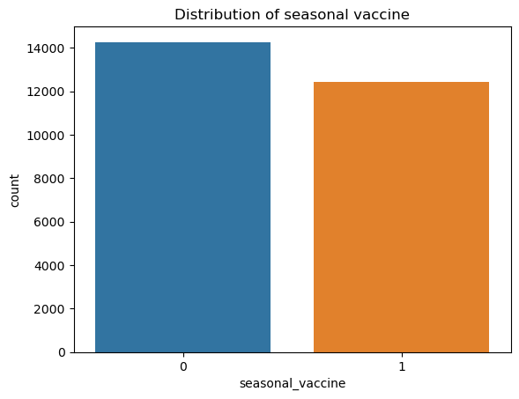
DATA UNDERSTANDING AND EXPLORATION.

Slide 5
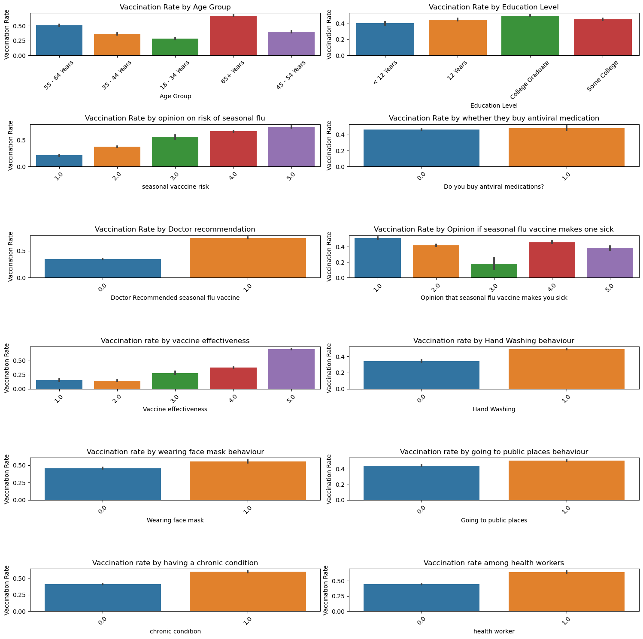

Slide 6
INSIGHTS:
The following characteristics/behaviors are associated with more seasonal flu vaccine uptake:
1. People with chronic health conditions.
2. Health worker profession.
3. Belief that the vaccine is efficacious.
4. Recommendation on the seasonal flu vaccine uptake by a doctor.
5. Awareness of the risks associated with the seasonal flu.
6. People over 65 years
7. People who wear facemasks and wash hands are more likely to take the seasonal flu vaccine

Slide 7
CORRELATION
We want to know which factors are most associated with seasonal flu vaccine.

Slide 8
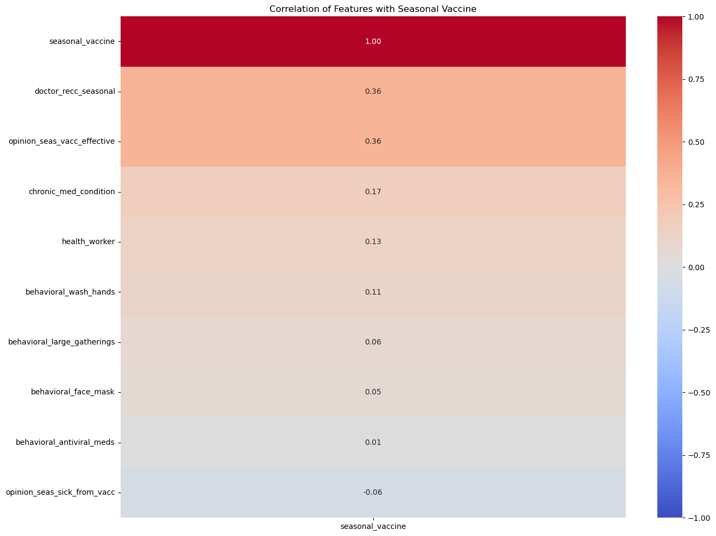
HEATMAP

Slide 9
CORRELATION
We can conclude that being aware of the risks associated with the seasonal flu has the highest correlation with the uptake of the seasonal flu vaccine. This means that people should be sensitized more on the risks associated with the seasonal flu.
Other factors:
- Opinion that the vaccine is very safe.
- Recommendation by a doctor

Slide 10
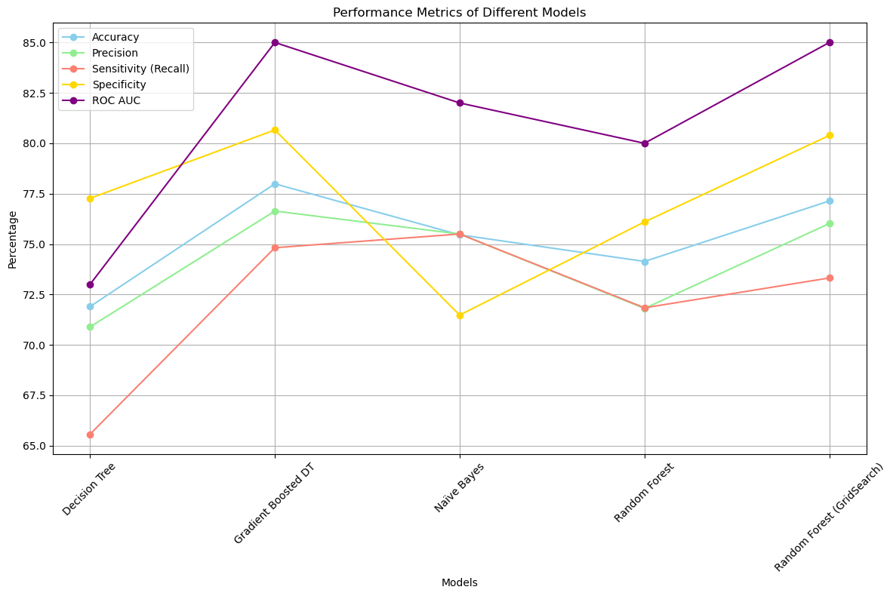
MACHINE LEARNING

Slide 11
The model of choice to use to predict whether people will take the vaccine is the gradient boosted Decision Tree.
That is the algorithm we will use to create our model.

Slide 12
RECOMMENDATIONS
Emphasize vaccine efficacy. Highlight the effectiveness of the vaccine in preventing flu-related complications while at the same time raising awareness on the risks associated with seasonal flu.
Promote Doctor recommendations. Encourage healthcare providers to recommend seasonal flu vaccination to their patients, especially those with chronic health conditions.
Implement targeted vaccination campaigns aimed at older people. Avail more vaccines to nursing homes.
Promote hygiene practices such as wearing facemasks and washing hands. These seem to promote health seeking behavior consequently leading to increased uptake of the seasonal flu vaccine.

